Slide 1
the dom
IN712 Web 3

Slide 2
The DOM
One of the great strengths of JavaScript is that it allows us to modify the web page from the browser (i.e. without having to request new HTML from the server)
To programmatically access the elements and attributes within the HTML a programming interface (API) called the Document Object Model is used
The HTML DOM is a standard object model and programming interface for HTML. It defines:
  The HTML elements as objects
  The properties of all HTML elements
  The methods to access all HTML elements
  The events for all HTML elements
The HTML DOM is a standard for how to get, change, add, or delete HTML elements

Slide 3
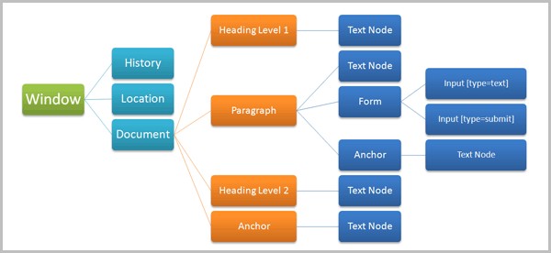
The DOM

Slide 4
The DOM
The browser doesn’t use the HTML representation of the page when rendering and managing it.
Rather, it parses the HTML and builds a complex hierarchical data object that represents the structure and the content of the page.
This structure is a tree.
Each element (including the HTML element itself) is a node.
The contents of elements are their children.
Multiple elements contained within a single containing element are siblings. And so on.

Slide 5
The DOM
Note that HTML has a naturally hierarchical structure: The <html> is the root node, and it contains two children, head and body. They in turn contain children. For example, the body can have two children, an h1 and a <p>. The p can have children of its own, a text fragment, an <i> (itself an element containing one text fragment child) and another text fragment for instance.
Note that leaf nodes are always content: text, an img or an input control. Internal nodes are always elements.
Working with the DOM involves selecting elements of this tree, traversing this tree, processing elements of this tree, and adding and deleting elements from this tree.
Each time you modify the DOM (the structure and/or the content), the browser rerenders it. No server contact to get fresh HTML is required

Slide 6
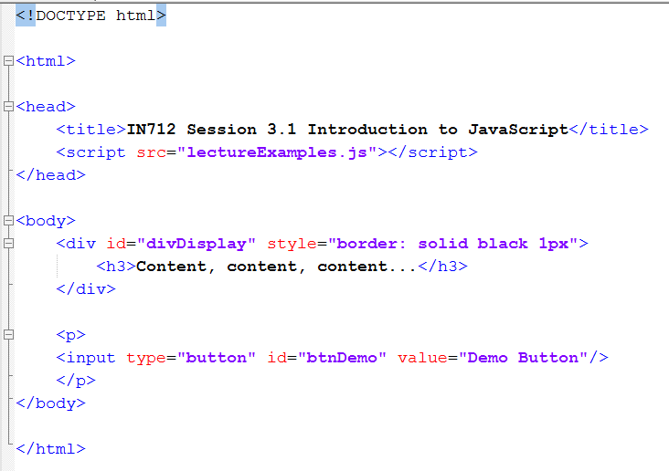
Modifying the Web Page
*I have styled the div inline here, just so you can see the style on the same page. Never do this for real. Always put your CSS in a separate file

Slide 7
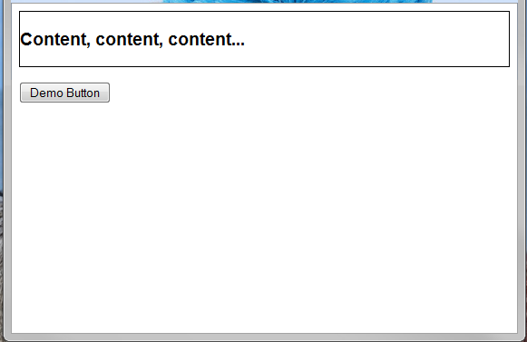
Modifying the Web Page

Slide 8
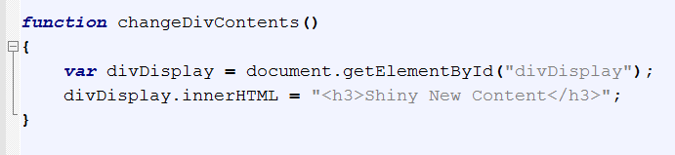
Modifying the Web Page

Slide 9
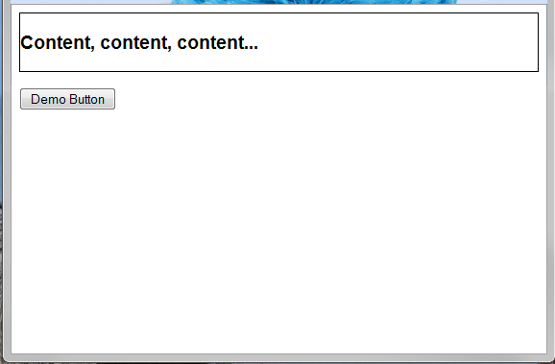
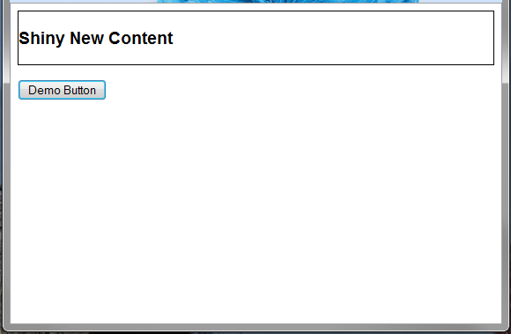
Modifying the Web Page
Notes:
Before and after.

Slide 10

Another very useful selector
querySelector() allows selection of Dom element based on CSS selectors syntax
Notes:
Before and after.

Slide 11
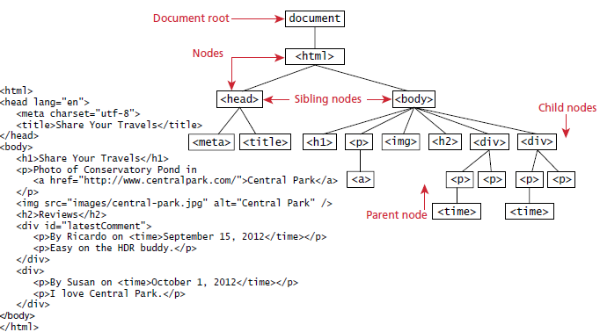
DOM tree

Slide 12
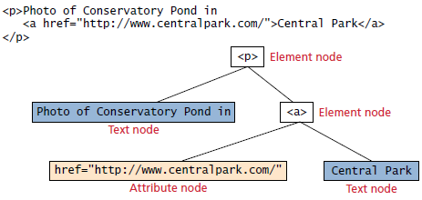
Nodes
In the DOM, each element within the HTML document is called a node
If the DOM is a tree, then each node is an individual branch
There are element nodes, text nodes, and attribute nodes
All nodes in the DOM share a common set of properties and methods
Most tasks in JavaScript involve finding a node, and then accessing or modifying it via those properties and methods

Slide 13
Element node object
The type of object returned by the method document.getElementById()
This represents an HTML element in the hierarchy, contained between the opening <> and closing </> tags for this element
An element can itself contain more elements
Since IDs must be unique in an HTML document, getElementByID() returns a single node, rather than a set of results which is the case with other selector functions

Slide 14
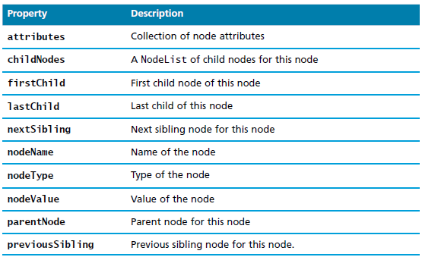
Some essential node object properties

Slide 15
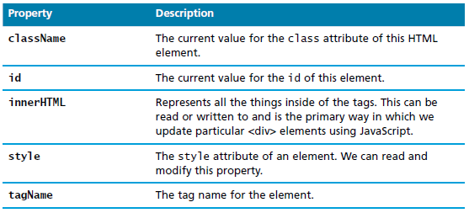
More essential node object properties

Slide 16
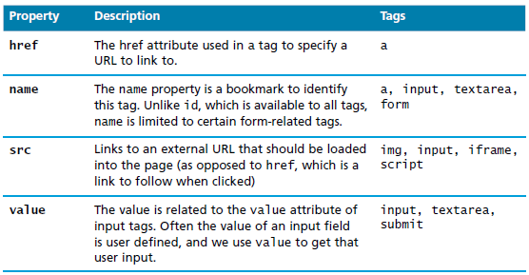
Some specific HTML DOM element properties for certain tag types

Slide 17
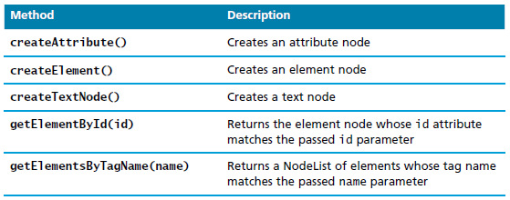
Some essential document object methods
getElementsByName(name)

Slide 18
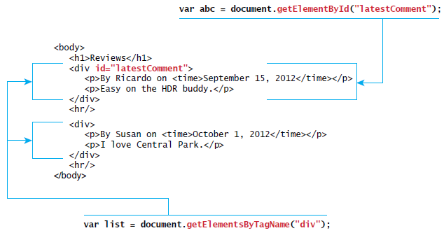
Relationship between HTML tags and getElementByID() and getElementsByTagName()

Slide 19
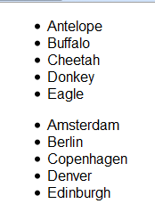
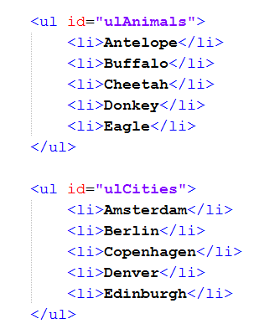
Selecting DOM nodes

Slide 20
Selecting DOM nodes
getElementById: var animalList holds (a pointer to) the first ul node.
allListItems holds all the li’s, animals and cities.
Note that you can chain these selectors. Var animalListItems holds only the animals, not the cities

Slide 21
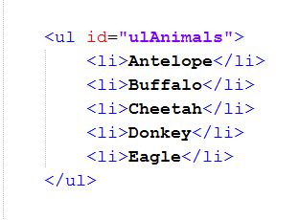
Caution!!
Be very careful when using these methods to traverse the DOM, because they are sensitive to white space in the html.
For example, these two HTML fragments look the same in the browser, but in the DOM, they are different.
The top one has 11 child nodes, 5 li and 6 line feeds
The bottom one has only the 5 li.

Slide 22
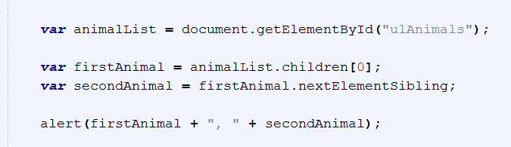
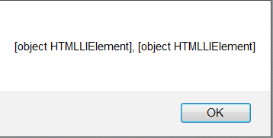
Example
Remember the tree.
These objects are <li> and when you print them, you see that
We need to access the text in the <li>, which is its child (i.e. the child of the <li> node)
Even when we get that child, we need to specify that we want its value, because text fragments are also nodes.

Slide 23
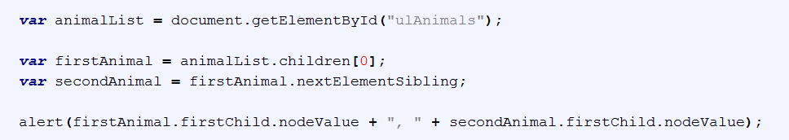
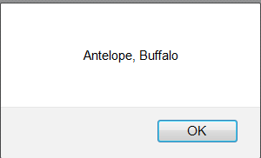
Example

Slide 24
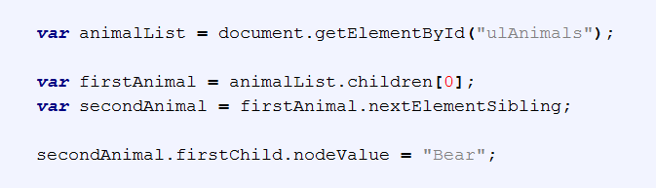
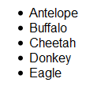
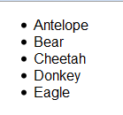
Example
Note that the nodeValue property is writable.

Slide 25


Modifying a DOM element
In many introductory JavaScript textbooks the document.write() method is used to create output at the bottom of the HTML page from JavaScript
The modern JavaScript programmer will want to write to the HTML page in a particular location

Slide 26

Changing and element’s style
We can also modify the style associated with a particular block.
We can add or remove any style using the style or className property of the Element node,

Slide 27
Modifying the DOM
appendChild(elementNode):
  Invoked on the element to which you wish to add the child
  elementNode becomes the last child of the target element
This is the real power – adding nodes to, or removing nodes from the DOM at runtime.

Slide 28
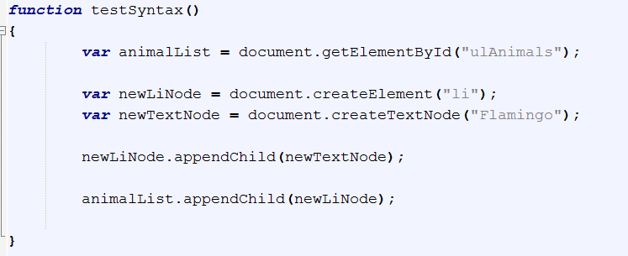
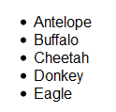
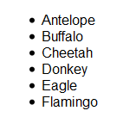
Modifying the DOM

Slide 29
Modifying the DOM
removeChild(n)
replaceChild(newNode, n)

Slide 30
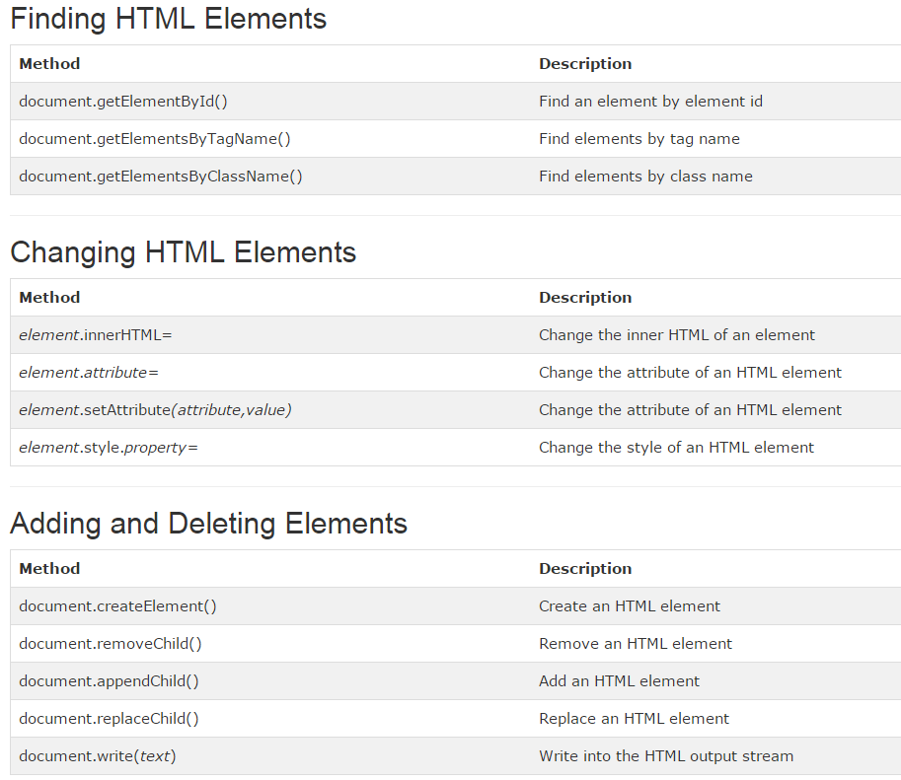

Slide 31
Performance
Note that every time you modify the DOM, the browser has to recompute and rerender the page representation. This can damage performance.
If you can do the same with CSS, always use CSS

Slide 32
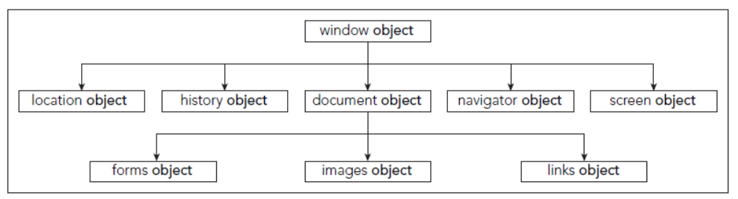
The Window Object

Slide 33
History object
history.go(-2)
history.back()
histroy.forward()

Slide 34
Location object
location.replace(http://www.google.com)
location.href = http://www.google.com

Slide 35
Navigator Object
navigator.appName
navigator.userAgent
Mozilla/5.0 (Windows NT 6.3; WOW64; Trident/7.0; .NET4.0E; .NET4.0C; .NET CLR 3.5.30729; .NET CLR 2.0.50727; .NET CLR 3.0.30729; rv:11.0) like Gecko

Slide 36

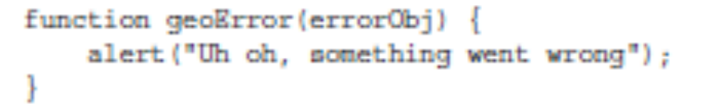
Geolocation Object
navigator.geolocation.getCurrentPosition(success, geoError)

Slide 37
Screen Object
screen.width
screen.height

Slide 38
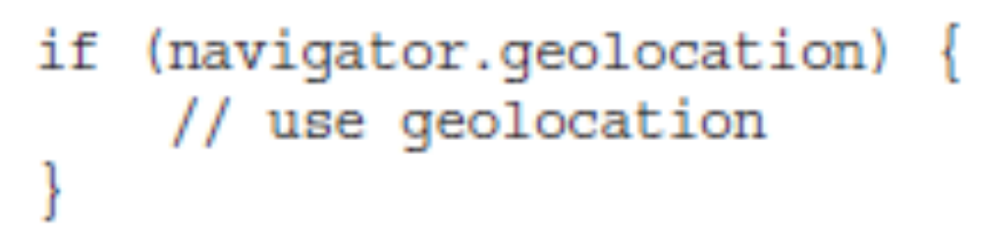
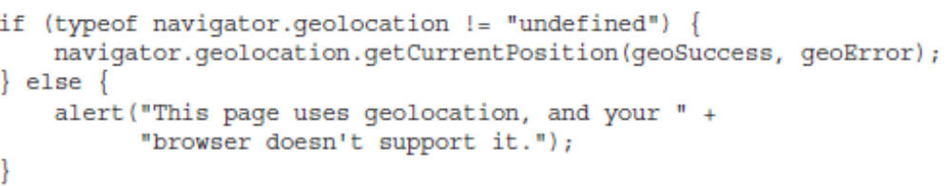
Feature Detection

Slide 39
Demo
https://dl.dropboxusercontent.com/u/10089854/domExample/index.html

