Slide 1
Ascenium Design speedup OpenROAD vs OpenSTA
Deepashree Sengupta

Slide 2
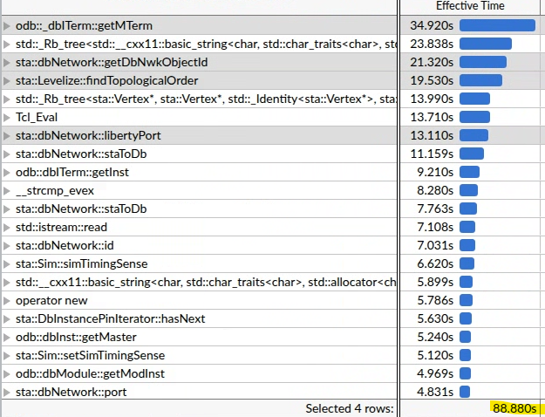
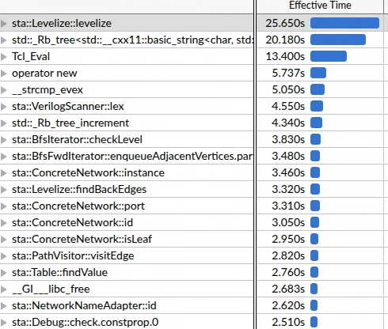
Initial discrepancy
OpenROAD | OpenSTA
delay_calc: find delays to level 9540 delay_calc: found 18125306 delays search: find arrivals pass 1 search: find arrivals to level 9540 search: found 17667978 arrivals [RUNTIME] Finished find_timing: 397.001s | delay_calc: find delays to level 9540 delay_calc: found 18142423 delays search: find arrivals pass 1 search: find arrivals to level 9540 search: found 18250499 arrivals [RUNTIME] Finished find_timing: 175.317s
Identical post-CTS design: read_db –hier OpenROAD, read_verilog in OpenSTA
CRPR disabled
Verbose: search 1, graph 1, delay_calc 1, path_group 2
sta::find_timing revealed a RUNTIME DIFFERENCE
OpenROAD
OpenSTA

Slide 3
Offending function: sta::dbNetwork::getDbNwkObjectId
Implemented 16-entry cache for primary object types: Pin, Instance, Net, Cell, Port, and Vertex for comparator memorization (works better than 1-slot cache)
latest master includes this potential speedup from Martin: dbSta: Use fast related net lookup · The-OpenROAD-Project-private/OpenROAD@4f6d246
Tried changing the concrete_ports_ and hier_modules_ in dbNetwork class to unordered_set to speed up the ::find functions, but that didn't make much dent in runtime
OpenROAD | OpenROAD with 16-slot cache | OpenSTA
delay_calc: find delays to level 9540 delay_calc: found 18125306 delays search: find arrivals pass 1 search: find arrivals to level 9540 search: found 17667978 arrivals [RUNTIME] Finished find_timing: 397.001s | delay_calc: find delays to level 9540 delay_calc: found 18125306 delays search: find arrivals pass 1 search: find arrivals to level 9540 search: found 17667978 arrivals [RUNTIME] Finished find_timing: 367.464s | delay_calc: find delays to level 9540 delay_calc: found 18142423 delays search: find arrivals pass 1 search: find arrivals to level 9540 search: found 18250499 arrivals [RUNTIME] Finished find_timing: 175.317s

Slide 4
Offending functions: sta::dbNetwork::libertyPort
findDelays and findArrivals are both slow in openroad even if there are fewer vertices to tackle (pg pins, physical only are filtered out). findDelays and findArrivals functions traverse millions of vertices. For each vertex, they call isDriver(), which calls direction(), which calls libertyPort().
dbNetwork::libertyPort(const Pin* pin) performs expensive sequence of operations for every pin: 1. Redundant Instance Lookup: converted pin to its parent instance (staToDb(pin) -> iterm->getInst() -> dbToSta(inst)). 2. Virtual Call Overhead: calls staToDb(inst) to check the instance type (involving virtual function calls). 3. Redundant Port Lookup: calls ConcreteNetwork::libertyPort(pin), which internally called port(pin), repeating the pin-to-port lookup all over again.
I have modified the implementation to directly extract the port from the pin (using the underlying OpenDB dbMTerm pointer) and skips the expensive instance and virtual type checks
OpenROAD | OpenROAD with 16-slot cache | OpenROAD with 16-slot cache + libertyPort | OpenSTA
[RUNTIME] Finished find_timing: 397.001s | [RUNTIME] Finished find_timing: 367.464s | [RUNTIME] Finished find_timing: 351.551s | [RUNTIME] Finished find_timing: 175.317s

Slide 5
Offending functions: sta::Levelize::findTopologicalOrder
Levelize::levelize(), findTopologicalOrder() is called unconditionally, but it doesn't show up as a bottleneck in OpenSTA but it does in OpenROAD
Keeps an account of # of incoming edges to a vertex using a map: std::map<Vertex*, int> in_degree;
I upgraded it to be a vector with index being the vertex id.
This improved OpenSTA runtime too and it went to 157s from 176s!
OpenROAD | OpenROAD with 16-slot cache | OpenROAD with 16-slot cache + libertyPort | OpenROAD with 16-slot cache + libertyPort + topoFix | OpenSTA | OpenSTA + topoFix
[RUNTIME] Finished find_timing: 397.001s | [RUNTIME] Finished find_timing: 367.464s | [RUNTIME] Finished find_timing: 351.551s | [RUNTIME] Finished find_timing: 339.67s | [RUNTIME] Finished find_timing: 175.317s | New baseline 157s?

Slide 6
Offending functions: sta::ExceptionsTo::matches()
Revisited getDbNwkObjectId: After comparator speedup, next was the ExceptionsTo::matches(), another caller of getDbNwkObjectId
Optimized getDbNwkObjectId to prioritize the most frequent object types (dbInst and dbNet).
Added a small cache directly inside ExceptionsTo class to optimize frequent checks done from ExceptionsTo::matches()
This improved OpenSTA runtime too and it went to 155s!
OpenROAD | OpenROAD with 16-slot cache | OpenROAD with 16-slot cache + libertyPort | OpenROAD with 16-slot cache + libertyPort + topoFix | OpenROAD with 16-slot cache + libertyPort + topoFix + freqObj + exceptnCache | OpenSTA | OpenSTA + topoFix+exceptnCache
[RUNTIME] Finished find_timing: 397.001s | [RUNTIME] Finished find_timing: 367.464s | [RUNTIME] Finished find_timing: 351.551s | [RUNTIME] Finished find_timing: 339.67s | [RUNTIME] Finished find_timing: 326.25s | [RUNTIME] Finished find_timing: 175.317s | New baseline 155s?

Slide 7
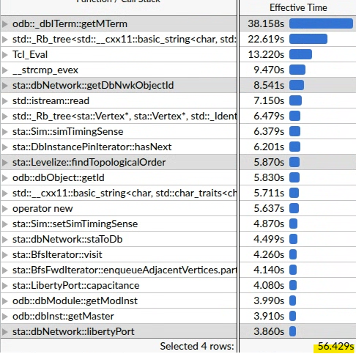
Change in profile
OpenROAD Profile after
16-slot cache
libertyPort refactor
vector in findTopologicalOrder
getDbNwkObjectId to prioritize dbInst and dbNet
cache in ExceptionsTo
Some minor increases, but top 4 functions targeted show reduced runtime

Slide 8
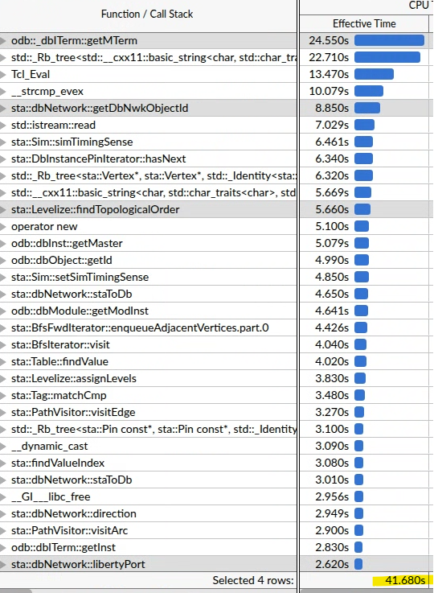
Offending functions: odb::_dbITerm::getMTerm
Further analysis with PR from Matthttps://github.com/The-OpenROAD-Project-private/OpenROAD/pull/3154
OpenROAD with 16-slot cache + libertyPort + topoFix + freqObj + exceptnCache | OpenROAD with 16-slot cache + libertyPort + topoFix + freqObj + exceptnCache + getMTermEnh
[RUNTIME] Finished find_timing: 326.25s | [RUNTIME] Finished find_timing: 309.264s

Slide 9
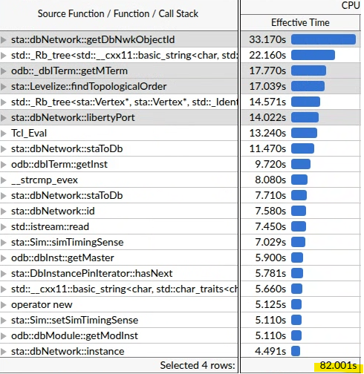
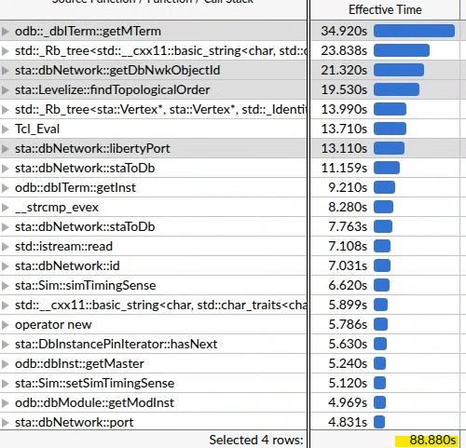
More: odb::_dbITerm::getMTerm
Just the PR from Matthttps://github.com/The-OpenROAD-Project-private/OpenROAD/pull/3154 doesn’t help much
OpenROAD | OpenROAD+getMTermEnh
[RUNTIME] Finished find_timing: 397.001s | [RUNTIME] Finished find_timing: 391.996s

Slide 10
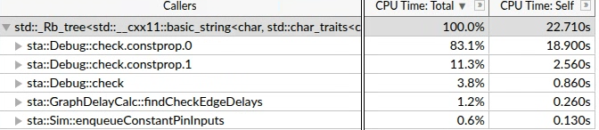
Discussions
Runtime bottleneck: std::_Rb_tree<std::__cxx11::basic_string<char, std::char_traits<char>, std::allocator<char>>, std::pair<std::__cxx11::basic_string<char, std::char_traits<char>, std::allocator<char>> const, int>, std::_Select1st<std::pair<std::__cxx11::basic_string<char, std::char_traits<char>, std::allocator<char>> const, int>>, std::less<std::__cxx11::basic_string<char, std::char_traits<char>, std::allocator<char>>>, std::allocator<std::pair<std::__cxx11::basic_string<char, std::char_traits<char>, std::allocator<char>> const, int>>>::find.isra
from sta::ArrivalVisitor::visitFromToPath to debugPrint function
costly due to millions of calls
equal bottleneck in OpenSTA and OpenROAD
tried disabling for RELEASE build, OpenSTA: 141s, OpenROAD: 270s (not profiled)

